Slide 1
Emergency Class Manager
Katie Hoskins, Tanya Peacock, Marcus Stange

Slide 2
Outline
Technologies
Design
Future Work

Slide 3
Emergency Class Manager
Purpose
Make the process of marking students’ presence in class during emergency situations or drills in Elementary Schools
Problems Solved
CMCSS students are checked in class manually by teachers through a spreadsheet
Higher chance for errors
Accessible by smartphone through a web browser if teachers do not have their laptop

Slide 4
Technologies
VSCode
Supabase
Vue3
Vuetify

Slide 5
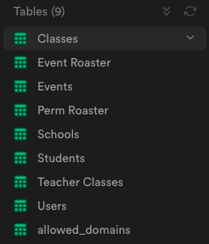
Database Design
Methods
loadRows
showInfo
showModal Tables
Classes
Event Roster
Events
Perm Roster
Schools
Students
Teacher Classes
Users
allowed_domains

Slide 6
Design
Components
Confirmation.vue
EditClasses.vue
EditTeachers.vue
Layouts
AppBar.vue
Default.vue
Views
Base Pages
Contact.vue
SignIn.vue
Home.vue
In Pages
Dashboard
Account.vue
Roster.vue
TeacherEvents.vue
Users.vue
Classes.vue
Events.vue
AddStudents.vue
TeachContact.vue

Slide 7
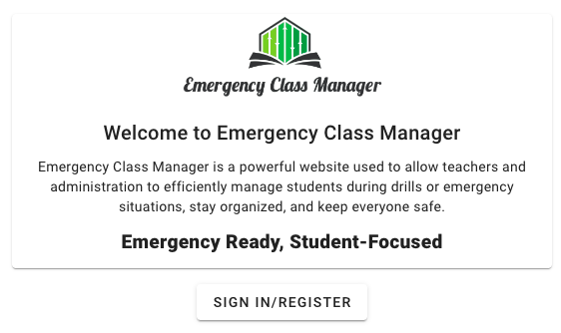
Contact, Sign In, and Home
Contact
Contact information for Katie, Tanya, and Marcus
Able to send emails
Sign In
Sign into the website
Home Page
Shows information about the website

Slide 8
Dashboard, Account, Roster, TeacherEvents, and TeachContact
Available to everyone
Dashboard
Home page showing events for today
Account
All information on signed in account
Roster
A place for teachers to submit reports on their classes during an event
TeacherEvents
A calendar to show all events
TeachContact
Contact info for all administration in the user’s school
Able to send emails

Slide 9
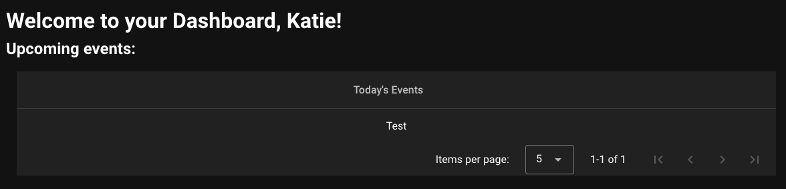
Dashboard
Methods
loadRows
showInfo
showModal

Slide 10
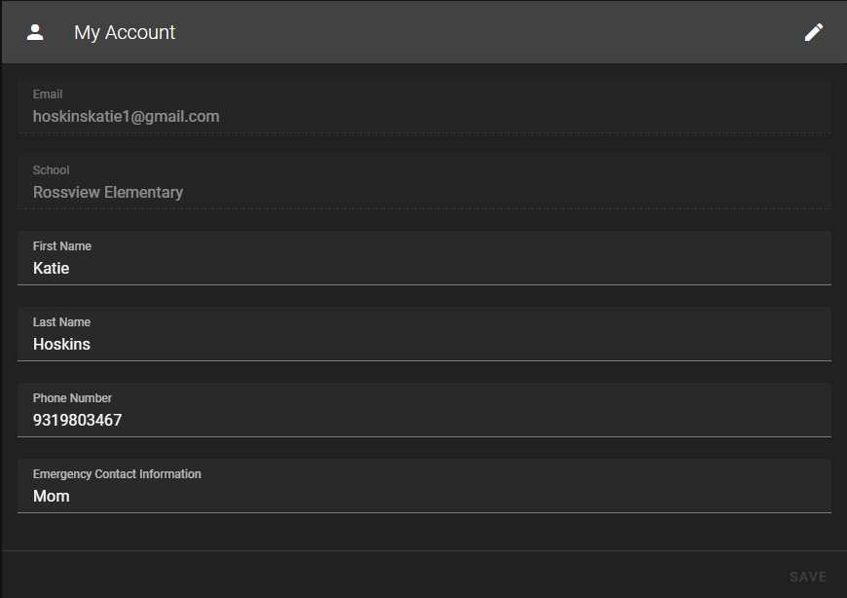
Account
Methods
fetchUserData
toggleEditing
handleInput
saveChanges

Slide 11
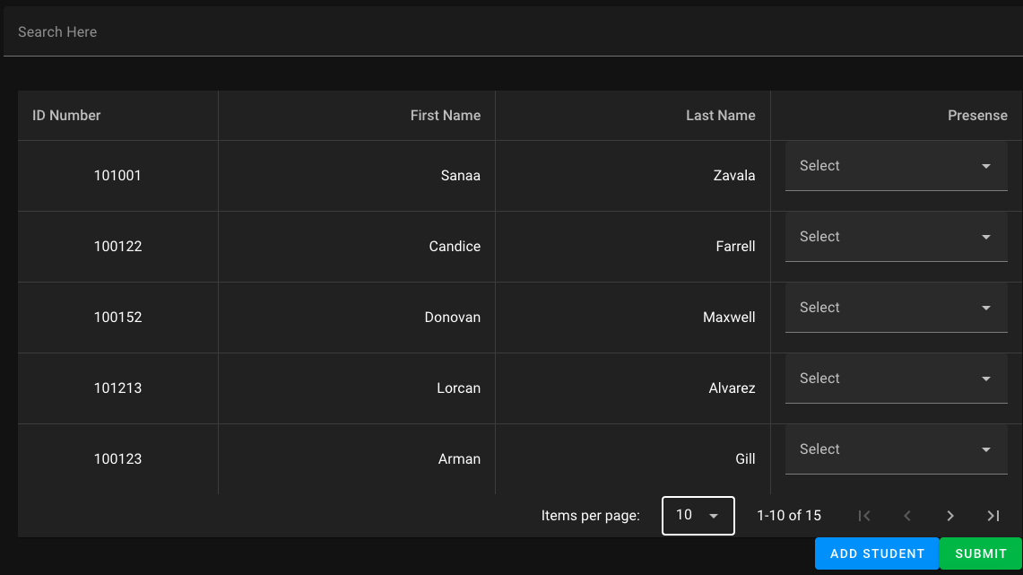
Roster
Methods
fetchUserData
updateStudentInfo
addStudent
loadRows
searchRows

Slide 12
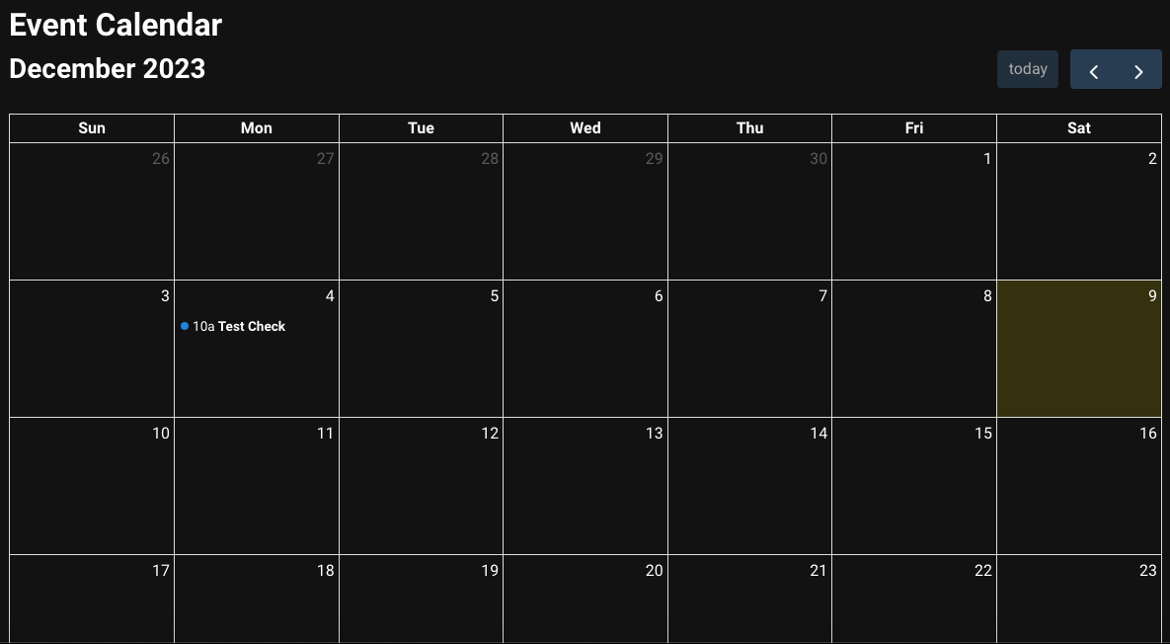
TeacherEvents
Methods
handleEventClick
fetchUserData

Slide 13
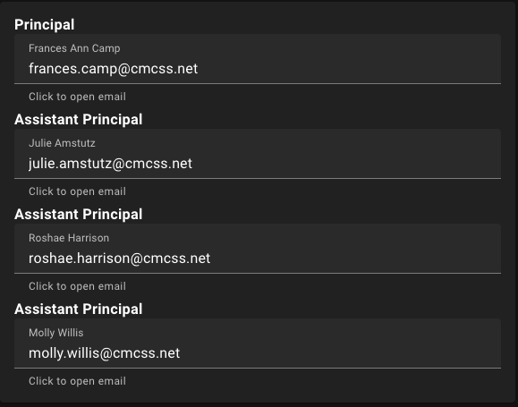
TeachContact
Methods
openEmail
fetchUserData

Slide 14
Users, Classes, Events, and AddStudents
Available to admin only
Users
Shows and edit users
Classes
Shows and edits classes
Add students to classes
Add teachers to classes
Events
Create events
Shows calendar
AddStudents
Add and delete students from the database

Slide 15
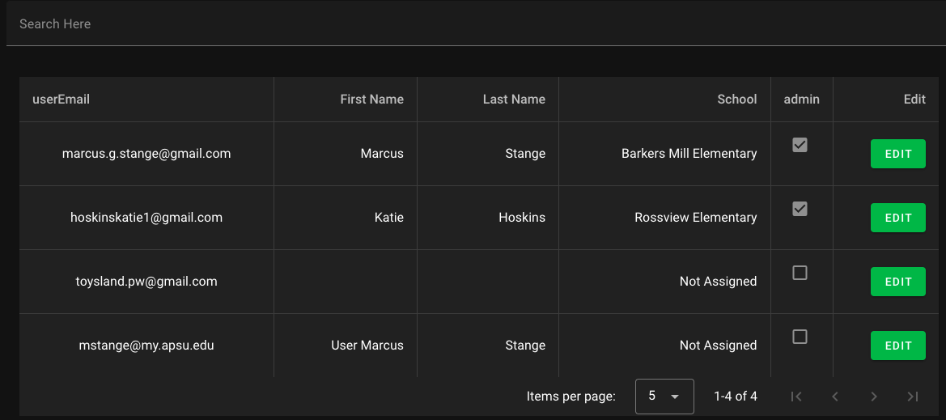
Users
Methods
getSuperAdmin
loadRows
searchRows
schoolSearch
editRow
updateSchool
submit

Slide 16
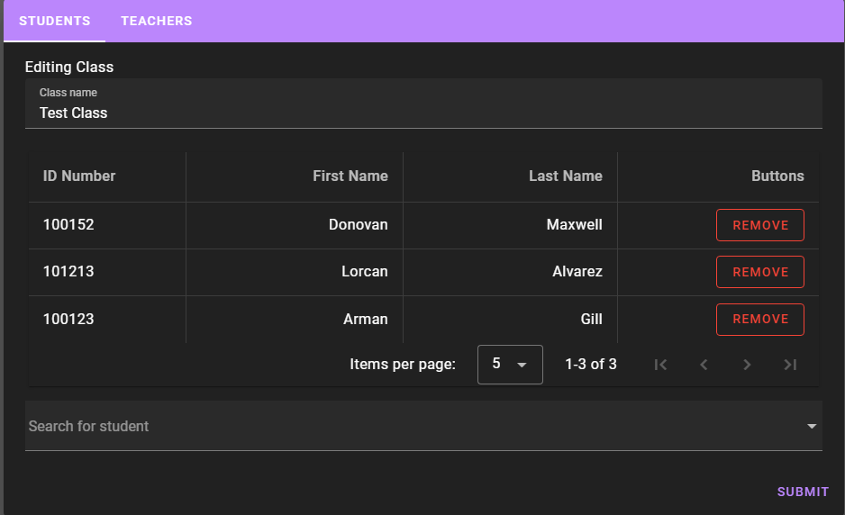
Classes
Methods
loadRows
searchRows
editRow
addRow
refresh

Slide 17
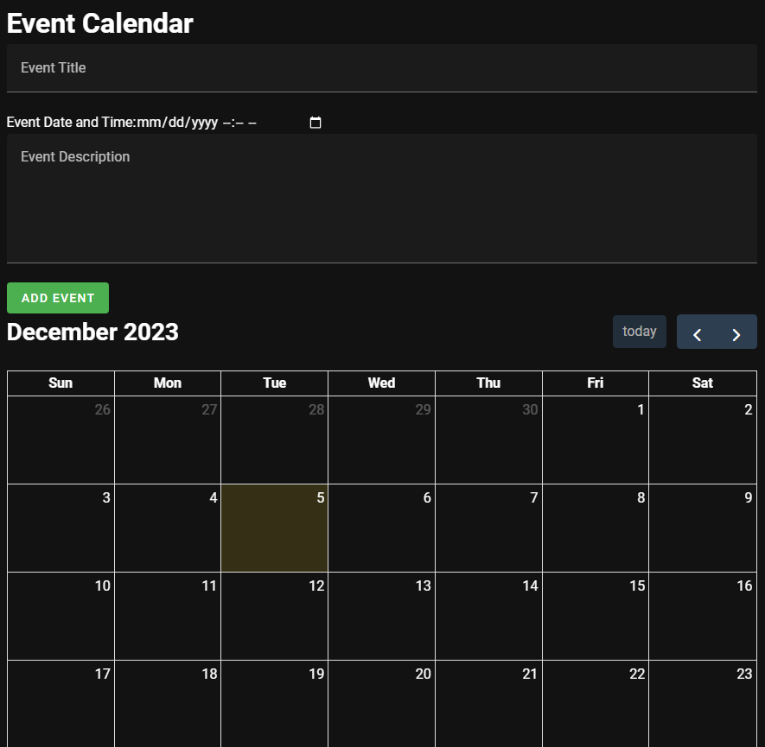
Events
Methods
handleEventClick
addEvent
fetchUserData
insertData
deleteEvent
cancelDelete
openConfirmDeleteDialog

Slide 18
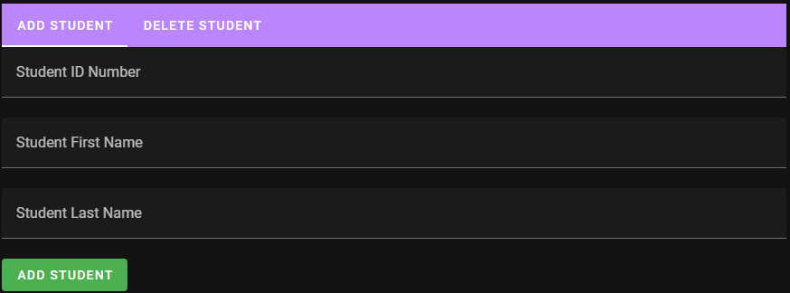
AddStudents
Methods
addStudent
deleteStudent
fetchUserData
updateData
confirmDelete
cancelDelete

Slide 19
Deployment
Download Repo
https://github.com/Toys0125/Emergency-Class-Manager
npm install
npm run dev
Server
Any website hosting provider or your own by running ‘npm run build’
Builds a static website
Database
Change supabaseUrl and supabaseAnonKey
Create the tables from the database

Slide 20
Known Bugs
Unable to add a student with the same id_number
Able to add a student to a class even if they are not assigned to that school
Able to view all classes for any school

Slide 21
Future Work
Archives page
More school implementation
Chat implementation
Automatic roster submission
Better calendar implementation

Slide 22
Live Demo

